Slide 1
Instrumental Variables
November 5/7, 2024

Slide 2
Outline for the Session
When is the treatment exogenous?
When is the treatment endogenous?
What is an IV and how does it work?
Operationalizing IVs
Source of IVs

Slide 3
When is the Treatment Exogenous?

Slide 4

Exogenous Treatment
Exogeneity of a treatment relies on two assumptions:
SUTVA
Ignorability/Unconfoundedness: $\left(Y_{i}^{T},Y_{i}^{C}\right)⊥T$
Random assignment of treatment insures that treatment is independent of outcome. Thus, treatment and control groups are the same and any selection bias is erased

Slide 5
When is the Treatment Endogenous?

Slide 6

The Potential Outcomes Approach
When our randomized design is either an encouragement design or we have imperfect compliance
In this case, actual treatment $(T)$ is distinct from the variable that is randomly manipulated$\left(Z\right)$
We can then define the compliance type of an individual
The type of an individual describes the level of treatment that an individual would receive given each value of the instrument. So we have $T_{i}(Z)$

Slide 7


Example
Encouragement design
Treated Village (Z)
Control Village

Slide 8

Example
Only some people adopt
Actual Treatment (T)
Treated Village (Z)
Control Village

Slide 9


The Potential Outcomes Approach
Four types of individuals $T_{i}(Z)$
Never-takers: $T_{i}\left(0\right)=T_{i}\left(1\right)=0$
Compliers: $T_{i}\left(0\right)=0,T_{i}\left(1\right)=1$
Defiers: $T_{i}\left(0\right)=1,T_{i}\left(1\right)=0$
Always-takers: $T_{i}\left(0\right)=T_{i}\left(1\right)=1$
 |  | $$Z_{i}$$
 |  | $$0$$ | $$1$$
$$T_{i}$$ | $$0$$ | Never-takers/Compliers | Never-takers
 | $$1$$ | Always-takers | Always-takers/Compliers

Slide 10

The Potential Outcomes Approach
Given the observed data $(Z_{i},T_{i},Y_{i})$ we cannot tell the difference between
A complier and an always-taker
A complier and a never-taker
What we require is some additional assumptions that will allow us to identify the complier from the always-taker

Slide 11

The Endogenous Regressor Approach
When random assignment does not exist and we must use observational data
Treatment assignment may not be independent of outcome
Ignorability/Unconfoundedness assumption no longer holds
In the regression context: $Y_{i}=α+βT_{i}+ε_{i}$
We can no longer assume $Cov\left(T_{i},ε_{i}\right)=0$
This violates a principal assumption of OLS

Slide 12

Case 1: Treatment Assignment is Non-Random
This is endogeneity due to targeting or program placement
If targeting or program placement is based on observables the solution is easy
We can just include the relevant covariates
$Y_{i}=αX_{i}+βT_{i}+ε_{i}$
By including the relevant covariates in $X_{i}$ we can ensure that treatment, conditional on those observables, is no longer correlated with the error term

Slide 13

Case 2: Treatment Assignment is Non-Random and Affected by Unobservables
This is endogeneity due to unobserved heterogeneity
Including covariates no longer solves the problem
Since treatment is dependent on something we cannot observe, that missing or omitted variable ends up in the error term
$Cov\left(T_{i},ε_{i}\right)≠0$
In this situation we require a variable that can instrument for the endogenous treatment and break correlation between the treatment and the error term

Slide 14
Summary and Discussion
In both the Potential Outcome Approach and in the Endogenous Regressor Approach we require a set of assumptions and relevant data that will allow us to identify the causal effect.
These assumptions are called Identification Assumptions and the relevant data are called Instrumental Variables

Slide 15
What is an IV and How Does it Work?

Slide 16

Identification Assumptions
SUTVA
Exogeneity of the instrument
Non-zero average effect of $Z$ on $T$
Monotonic effect of Z on T

Slide 17
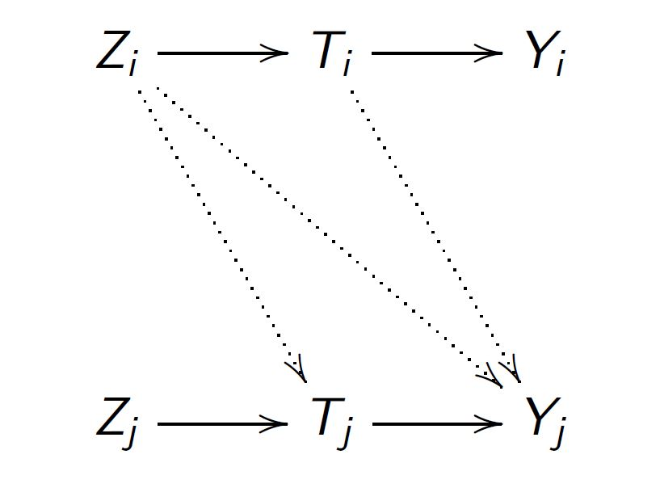

1. SUTVA
$Z_{i}$ does not affect $T_{j}$ and $Y_{j}$ and $T_{i}$ does not affect $Y_{j}$ for all $i≠j$ (non-interference)
The value of my instrument or the status of my treatment does not affect your treatment or your outcome

Slide 18

2. Exogeneity of the Instrument
All potential outcomes are independent of the instrument
$${(Y_{i}\left(0\right),Y_{i}\left(1\right),T}_{i}\left(0\right),T_{i}\left(1\right))⊥Z_{i}$$
This assumption is really made up of two assumptions

Slide 19
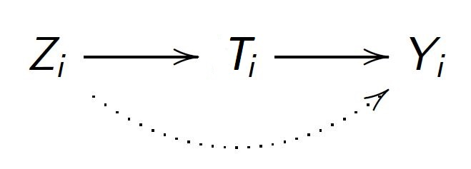

2. Exogeneity of the Instrument
2A. Ignorability/Unconfoundedness of $Z_{i}$
Instrument is not correlated with any unobservables that affect the outcome so that its effect on the outcome and treatment received can be consistently estimated
2B. Exclusion Restriction
There is no direct effect of the instrument on the outcome. Any effect of $Z_{i}$ on $Y_{i}$ must be through the treatment$T_{i}$
$Cov\left({Z_{i},ε}_{i}\right)=0$

Slide 20


3. Non-Zero Average Effect of $Z$ on $T$
Instrument must be correlated with treatment
$$Cov\left({Z_{i},T}_{i}\right)≠0$$

Slide 21

4. Monotonicity
Increasing the level of the instrument does not decrease the level of the treatment
$$T_{i}\left(1\right)≥T_{i}\left(0\right) ∀ i$$
This amounts to their being no defiers

Slide 22
Instrumental Variables
A variable that is a valid instrument for the endogenous treatment is any variable that satisfies the above identifying assumptions
By using an IV, we are able to isolate the part of the treatment variable that is independent of other unobserved characteristics affecting the outcome

Slide 23

Imagine this is what we want to run:
$$Y_{i}=αX_{i}+βT_{i}+ε_{i}$$
but T is endogenous, so we use an instrument Z.
We first run: $T_{i}=β_{1}Z_{i}+φX_{i}+u_{i}$
to get the effect of Z on T. This is equivalent to stripping out all of the variation in T that is not explained by Z, and throwing it away (in the residual of the first stage).
Essentially, we’re left with: Cov(Z, T)/V(T) in the first stage.

Slide 24

Next we want to relate this to the effect of Z on Y…
$Y_{i}=αX_{i}+β_{2}Z_{i}+ε_{i}$ (Note that this gives you the ITT)
Then the IV estimate of treatment on outcome is: $β_{iv}={β_{2}/β}_{1}$ (called the LATE, or local average treatment effect)
where $β_{1}=∂T_{i}/∂Z_{i}$
Note that the LATE is just a scaled version of the ITT, where it is scaled by the correlation of T and Z.
The LATE explains the effect of treatment only for those who are induced to change into treatment by Z.

Slide 25
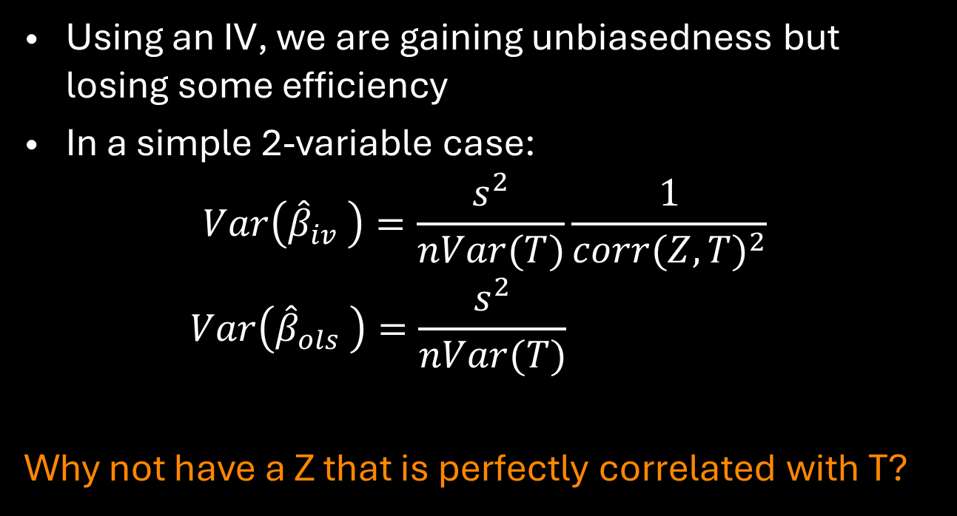
One drawback
Using an IV, we are gaining unbiasedness but losing some efficiency
In a simple 2-variable case:
$$Var\left({\hat{β}}_{iv} \right)=\frac{s^{2}}{nVar(T)}\frac{1}{{corr(Z,T)}^{2}}$$
$$Var\left({\hat{β}}_{ols} \right)=\frac{s^{2}}{nVar(T)}$$
Why not have a Z that is perfectly correlated with T?

Slide 26

Recap
But we don’t want the correlation between X and Z to be too small
Note that our IV estimate is equal to the ‘true’ beta plus potential bias:
$\hat{β_{iv}}=β+\frac{Cov\left(u_{i},Z_{i}\right)}{Cov\left(T_{i},Z_{i}\right)}$

Slide 27
Operationalizing IVs

Slide 28

Two-stage least squares (2SLS)
First, regress treatment on instrument and other exogenous variables
$$T_{i}=γZ_{i}+φX_{i}+u_{i}$$
Second, calculate the predicted treatment from this regression
$$\hat{T_{i}}=\hat{γ}Z_{i}+\hat{φ}X_{i}$$

Slide 29

Two-stage least squares (2SLS)
Third, replace $T_{i}$ with its predicted value $\hat{T_{i}}$ in to create the reduced form regression equation
$$Y_{i}=αX_{i}+β(\hat{γ}Z_{i}+\hat{φ}X_{i})+ε_{i}$$
In practice we estimate this in a single step
$$Y_{i}=αX_{i}+β\hat{T_{i}}+[ε_{i}+β(T_{i}−\hat{T_{i}})]$$
Note that the standard errors will be wrong

Slide 30
Recap of IV and 2SLS Lingo
Endogenous variables
Independent variables to be instrumented – is correlated with the error term
Treat an independent variable as endogenous
To instrument a variable, meaning to replace it with its fitted values in the second stage of the 2SLS procedure
Exogenous variables
Independent variables (and IVs) that are uncorrelated (orthogonal) with the error term
Use IV commands to ensure SE are correct

Slide 31

Calculating the ATE
If we had perfect randomization then we could run the following regression
$$Y_{i}=βT_{i}+ε_{i}$$
Then the Average Treatment Effect is just
$$β=ATE$$

Slide 32

Calculating the LATE
But our IV estimate of the treatment effect is:
$$\hat{β_{IV}}=β+\frac{Cov\left(u_{i},Z_{i}\right)}{Cov\left(T_{i},Z_{i}\right)}$$
This is only a local effect or LATE because it’s the effect of $T_{i}$ on $Y_{i}$ for the subpopulation of compliers, and not the whole

Slide 33
Specification tests

Slide 34

Durbin-Wu-Hausman Test
One should test for endogeneity of the treatment
First, regress $T_{i}$ on $Z_{i}$ and other exogenous covariates, $X_{i}$, and obtain the residuals, $\hat{u_{i}}$
These residuals reflect all unobserved heterogeneity affecting treatment not captured by the instruments
Second, regress $Y_{i}$ on $X_{i}$, $Z_{i}$, and $\hat{u_{i}}$
If the coefficient on $\hat{u_{i}}$ is significant, unobserved characteristics jointly affecting $T_{i}$ and $Y_{i}$ are significant then the null that $T_{i}$ is exogenous is rejected.
Note that this test assumes that the IV is valid and is not a test for the validity of the IV

Slide 35

Wu-Hausman Statistic
A.k.a. Hausman specification test
$$H=\left({\hat{β}}_{ols}−{\hat{β}}_{iv}\right)′{\left(Var({\hat{β}}_{iv})−Var({\hat{β}}_{ols})\right)}^{−1}\left({\hat{β}}_{ols}−{\hat{β}}_{iv}\right)$$
Assumes IV is unbiased
Compares degree of bias to efficiency loss

Slide 36

Weak Instruments
“Cure can be worse than the disease”
We don’t want the correlation between $T_{i}$ and $Z_{i}$ to be too small
$$\hat{β_{iv}}=β+\frac{Cov\left(u_{i},Z_{i}\right)}{Cov\left(T_{i},Z_{i}\right)}$$
Test predictive power in the first stage
F-stat of instrument(s)
For critical values, see (Stock and Yogo 2005)

Slide 37

Sargan-Hansen Test for Overidentification
No test exists to determine if the IV satisfies the exclusion restriction
Justification can only be made through direct evidence of how the program and participation evolved
One can test for overidentifying restrictions
First, estimate the structural equation by 2SLS and obtain ${\hat{ε}}_{i}$
Second, regress ${\hat{ε}}_{i}$ on $X_{i}$ and $Z_{i}$ and obtain the $R^{2}$
With a null of no correlation between $X_{i}$ and ${\hat{ε}}_{i}$, test if ${nR}^{2}$ is greater than the critical value. If so then at least one of the instruments is not exogenous

Slide 38
Source of IVs

Slide 39
What Qualifies as a Good IV?
So, where can you find a good instrument?
“Good instruments come from a combination of institutional knowledge and ideas about the process determining the variable of interest”
-Angrist and Pischke
Mostly Harmless Economics

Slide 40
What Qualifies as a Good IV?
An IV can be external or randomly assigned but that does not mean the IV is exogenous
External
A variable whose value is set outside of the causal system
It is “as good as” randomly determined
Exogenous
A variable that is uncorrelated with (orthogonal to) the error term
Satisfies both 2A (unconfoundeness/ignorability) and 2B (the exclusion restriction)

Slide 41
e.g. Bleakley and Lin (2012): Testing whether places with higher population density have higher wages
Trick: wages and population might be co-determined.
Solution: Use features that affect past population to predict current population
Bleakley and Lin (2012) consider ‘portage sites’ in the US: where waterborne goods had to be portaged over falls in the early-mid 1800s. Required lots of labor, induced settlements.
To identify portage sites, they use the ‘fall line’ where rivers become unnavigable from the ocean (i.e. first occurrence of rapids or falls)
Use portage sites to predict current population; then explain how that predicted population relates to wage (idea is that current wages do not affect past portage locations)
E.g. Oxford or Frankfurt

Slide 42
Design
in-migration
Fall line
(portage location)
Current population density
Wages
amenities, etc.

Slide 43
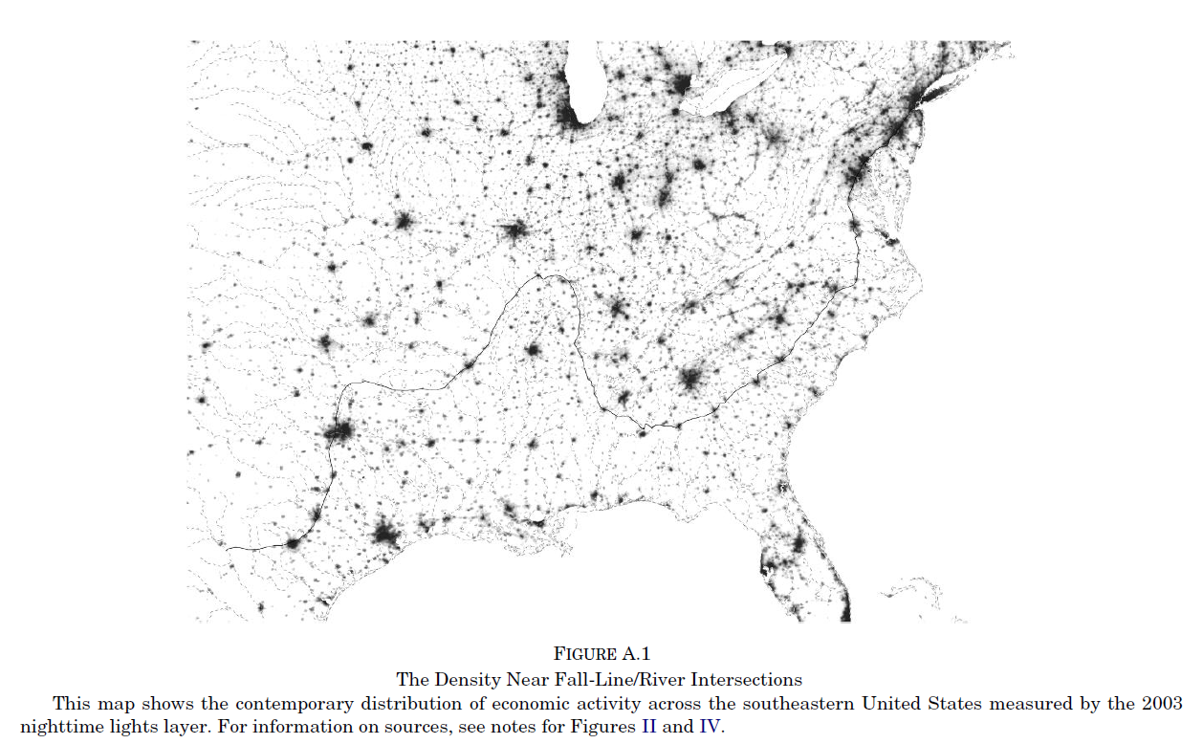
Fall line

Slide 44
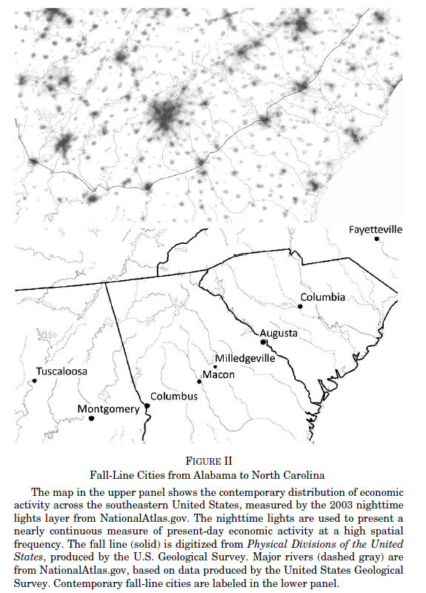

Slide 45


Slide 46
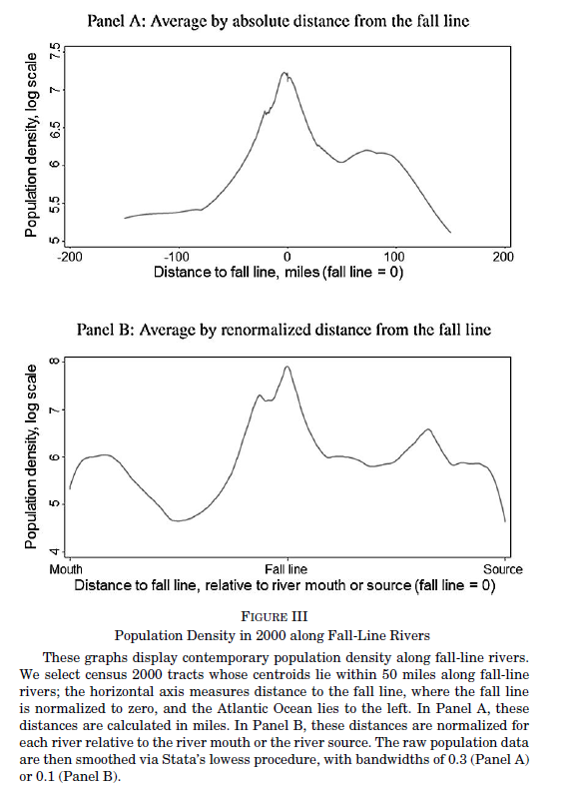

Slide 47
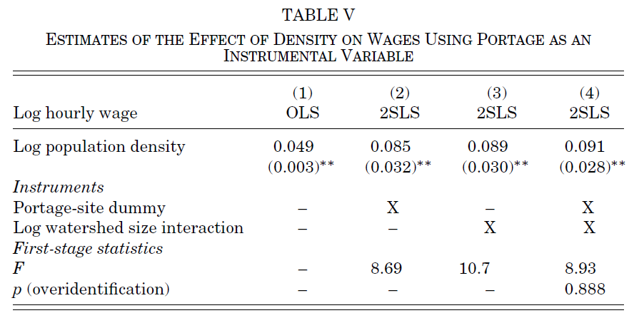

Slide 48
Punchline of Bleakley and Lin (2012)
Past citing of cities affects current population, even after natural advantage goes away
Current population (as explained by ‘fall line’) associated with higher wages today

Slide 49
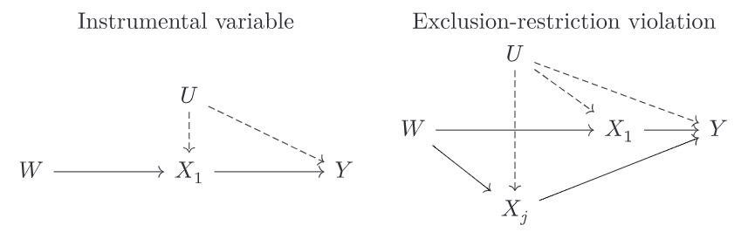
weather instruments… (Mellon 2024)
weather is often used as an instrument
For agricultural productivity when estimating the effect on conflict
For migration via migration networks when estimating
For maternal health when estimating effect on long-run child outcomes
(External but not necessarily exogenous)

Slide 50
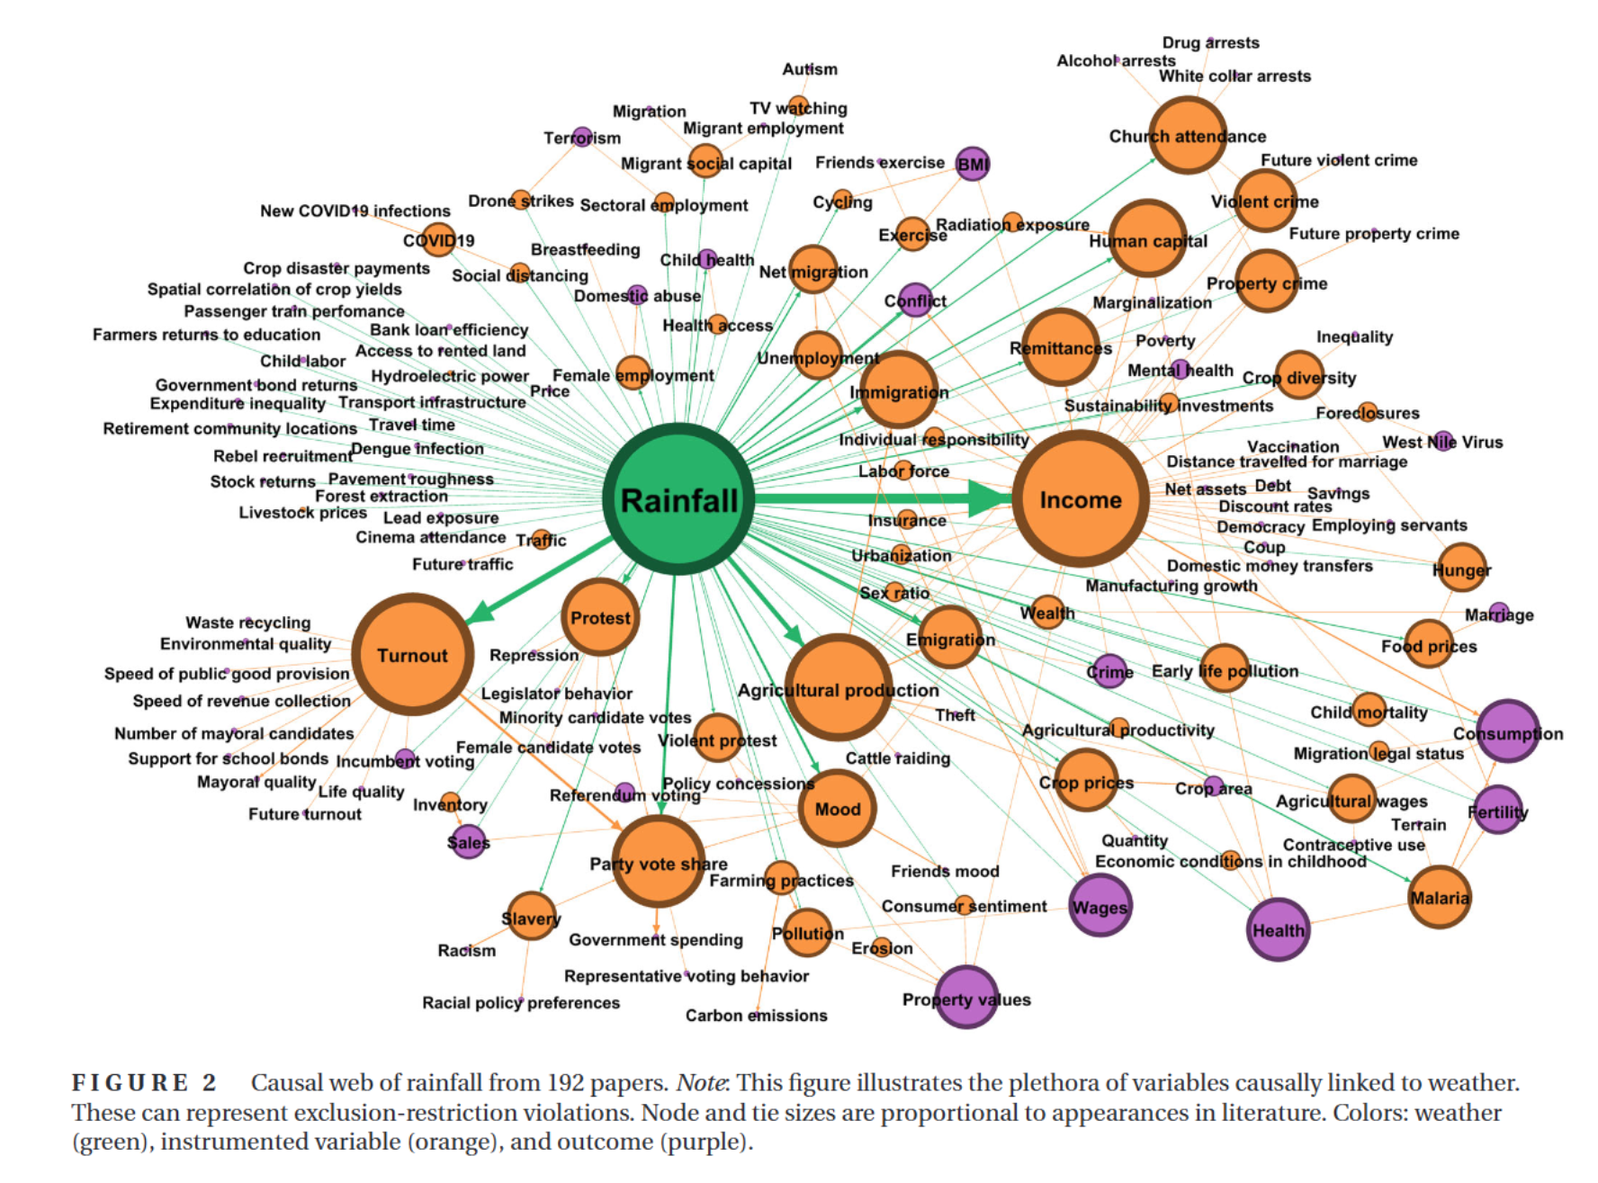

Slide 51

Discussion of IV Quality
Giles and Yoo, 2007, ReStat
$Y_{i}$: consumption; $T_{i}$: household migrant/network
$Z_{i}$: Rainfall shocks from distant past
Burgess et al., 2012, QJE
$Y_{i}$: deforestation; $T_{i}$: local government permit to log
$Z_{i}$: subdividing of local governments
Di Falco and Veronesi, 2013, Land Econ
$Y_{i}$: Net revenue; $T_{i}$: Adaptation strategy
$Z_{i}$: Access to information sources like extension

Slide 52
Critique: Deaton (2010)
Instruments: exogenous versus external
E.g. rail stations and poverty (river; earthquake)
Irrigation dams (land gradient)
Child class size; some people don’t stay treated (heterogeneous response to instrument)
Intent to Treat vs Treatment. Really evaluating those communities/individuals who were induced to change. May not be representative of all communities

Slide 53
Critique: Deaton (2010)
Important question is not ‘if it works’ but ‘why (or when and where) it works’
RCT:
relies on mean; what if distributions between T and C differ?
Heterogeneity (one guy wins big, everyone else loses)
Scaling up? (general equilibrium effects)
Generalizability – is it meaningful?
Controlling for other things can be a problem with heterogeneity
Tests of theory versus test of programs (help with external validity)

Slide 54
Types of Treatment Effects

Slide 55
Which Treatment Effect to Measure?
There are a number of different ways to measure the effect of treatment
ATE: Average Treatment Effect
ATT: Average Treatment Effect on the Treated
ATU: Average Treatment Effect on the Untreated
ITT: Intent to Treat Estimate
LATE: Local Average Treatment Effect
MTE: Marginal Treatment Effect

Slide 56
Which Treatment Effect to Measure?
Different treatment effects are an average over parts of the distribution of impacts
The ATE averages over the entire distribution
The ATT averages over the distribution of impacts for those allocated to the treatment
The LATE averages over the distribution of impacts for those who switch into the treatment as the result of a change in an some instrument

Slide 57
Which Treatment Effect to Measure?
These all represent an aggregation over different margins
As such, they are not comparable to each other
As a unifying measurement Heckman and Vytlacil (2005) defined the MTE
The MTE is the effect of the treatment on the marginal individual entering treatment

Slide 58
Basic Requirements
What is needed to measuring the treatment effect?
Assumptions
SUTVA
Ignorability/Unconfoundedness
Data
Observations on outcomes for those who were treated
Observations on outcomes for some constructed control group
Without observations from treated individuals and from some sort of control group we cannot measure the effect of the treatment!

Slide 59
What We Can Never Measure
Notice that all our measurements of treatment effects are averages
The Fundamental Problem of Causal Inference
We do not observe subject in simultaneous treated and untreated states
So, we can never determine the effect of the treatment on an individual
We can only ever determine the average effect of the treatment or the effect of the treatment on an average individual

